Slide 1

CSC3100 Data Structures
Tutorial 5

Slide 2
Roadmap
Stack Concept
Stack and List Exercise

Slide 3
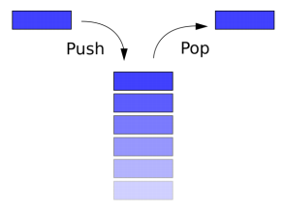
Stack
In computer science, a stack is an abstract data type that serves as a collection of elements, with two main operations:
1. Push, which adds an element to the collection
2. Pop, which removes the most recently added element that was not yet removed.
Uses of stacks?
  Implement recursive algorithms
  Compiling and running programs
  Backtracking algorithms like constraint satisfaction
  (e.g. Sudoku(数独))

Slide 4

Stack-FILO principle
A stack is a collection of objects that are inserted and removed according to the first-in, last-out (FILO) principle
The basic operations of a stack are push and pop

Slide 5
Exercise 1: sort by using two stacks
Use only 2 stacks to sort a sequence of numbers

Slide 6
Exercise 2:reverse
Given a linked list, write a function to reverse every k nodes (where k is an input to the function).
Example:
Input: 1->2->3->4->5->6->7->8->NULL, K = 3
Output: 3->2->1->6->5->4->8->7->NULL
Input: 1->2->3->4->5->6->7->8->NULL, K = 5
Output: 5->4->3->2->1->8->7->6->NULL

Slide 7
Solution 1:
You can use an array to store the value in the list and reverse the sequence as the question told you.
Array A[]
Int count=0
Node thead=head
While head!=null
A[count++]=head.val
head=head.next
For i from 0 to count-1
int group=i/K
int id=i-group*K
int swid=K-id
if id<K/2
swap(A[i], A[swid+group*K])
count=0
while thead!=null
thead.val=A[count++]
thead=thead.next
The time complexity would be O(n) but the memory complexity would be O(n), too
Can’t solve corner cases.

Slide 8
Solution 2
There is better solution. The time complexity would be O(n) while the memory complexity would be O(1).
You can download the code on BlackBoard and try to simulate some examples.

Slide 9
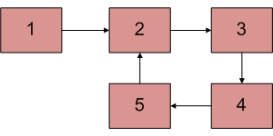
Exercise 3:detectAndRemoveLoop
Write a function detectAndRemoveLoop() that checks whether a given Linked List contains a loop and if the loop is present then removes the loop and returns true. If the list doesn’t contain a loop then it returns false. The below diagram shows a linked list with a loop. detectAndRemoveLoop() must change the below list to 1->2->3->4->5->NULL.

Slide 10
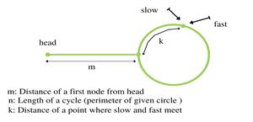
Brainstorm
In the last tutorial, we talked out how to judge whether there is a loop in a list : fast and slow pointer. If we know where the fast pointer and the slow pointer meet, how can we use it to remove the loop?

Slide 11
Distance traveled by fast pointer = 2 * (Distance traveled
by slow pointer)
(m + n*x + k) = 2*(m + n*y + k)
Note that before meeting the point shown above, fast
was moving at twice speed.
x --> Number of complete cyclic rounds made by
fast pointer before they meet first time
y --> Number of complete cyclic rounds made by
slow pointer before they meet first time

Slide 12
m + k = (x-2y)*n
Which means m+k is a multiple of n.
Thus we can write, m + k = i*n or m = i*n - k.
m=(i-1)*n+n - k (cover the loop completely i-1 times and start from n-k).
So if we start moving both pointers again at same speed such that one pointer (say slow) begins from head node of linked list and other pointer (say fast) begins from meeting point. When the slow pointer reaches the beginning of the loop (has made m steps), the fast pointer would have made also moved m steps as they are now moving at the same pace. Since m+k is a multiple of n and fast starts from k, they would meet at the beginning. Can they meet before also? No because slow pointer enters the cycle first time after m steps.

Slide 13
You can download the code on BlackBoard and try a few examples by yourself.

Slide 14
Q&A

